Slide 1
kNN & Naïve Bayes
Hongning Wang
CS@UVa

Slide 2
Today’s lecture
Instance-based classifiers
k nearest neighbors
Non-parametric learning algorithm
Model-based classifiers
Naïve Bayes classifier
A generative model
Parametric learning algorithm

Slide 3
How to classify this document?
Documents within vector space representation
?
Sports
Politics
Finance

Slide 4
Let’s check the nearest neighbor
Are you confident about this?
?
Sports
Politics
Finance

Slide 5
Let’s check more nearest neighbors
Ask k nearest neighbors
Let them vote
?
Sports
Politics
Finance

Slide 6
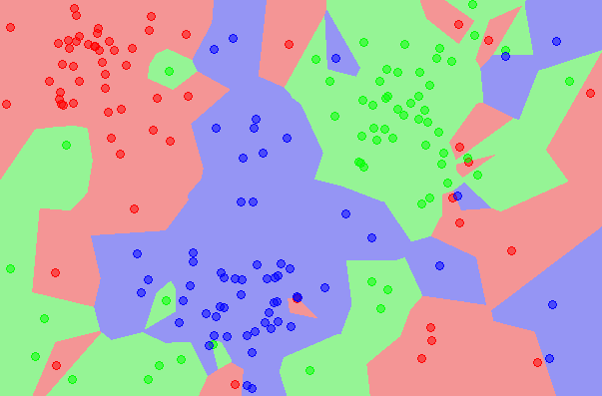
kNN is close to optimal
Asymptotically, the error rate of 1-nearest-neighbor classification is less than twice of the Bayes error rate
Decision boundary
1NN - Voronoi tessellation

Slide 7
Components in kNN
A distance metric
Euclidean distance/cosine similarity
How many nearby neighbors to look at
k
Instance look up
Efficiently relate to nearby points

Slide 8
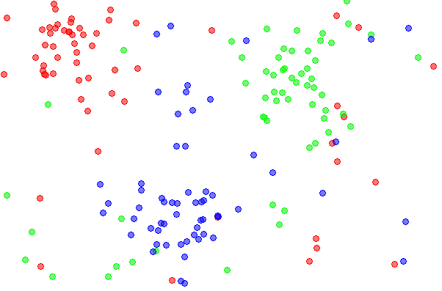
Effect of k
Choice of k influences the “smoothness” of the resulting classifier

Slide 9
Effect of k
Choice of k influences the “smoothness” of the resulting classifier

Slide 10
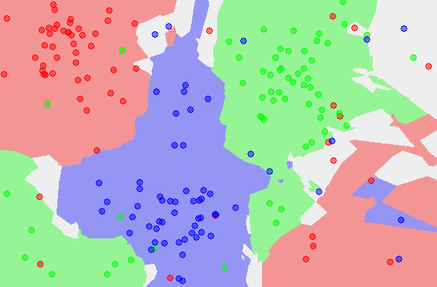
Effect of k
Choice of k influences the “smoothness” of the resulting classifier

Slide 11
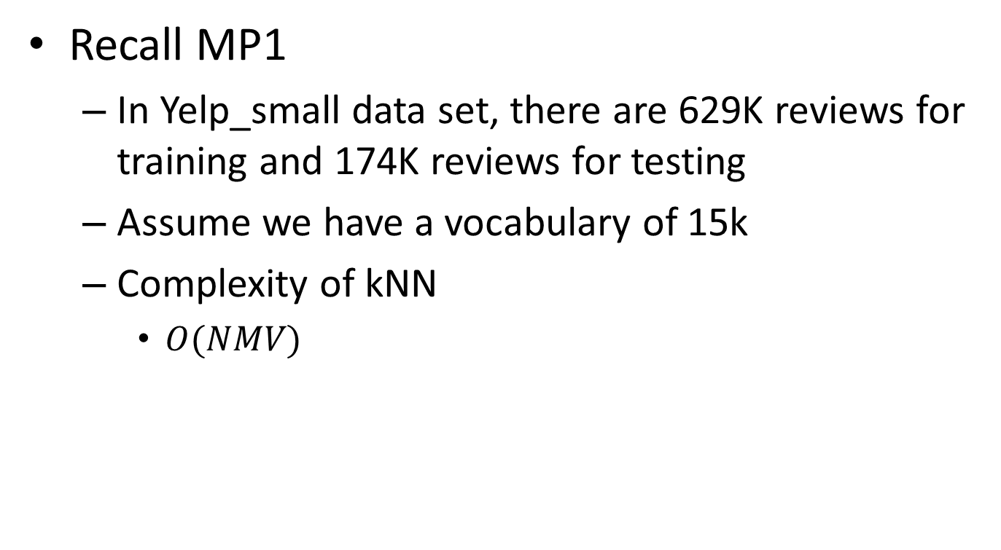
Efficient instance look-up
Recall MP1
In Yelp_small data set, there are 629K reviews for training and 174K reviews for testing
Assume we have a vocabulary of 15k
Complexity of kNN
$O(NMV)$
Feature size
Training corpus size
Testing corpus size

Slide 12
Efficient instance look-up
Exact solutions
Build inverted index for documents
Special mapping: word -> document list
Speed-up is limited when average document length is long
Parallel the computation
Map-Reduce
Map training data onto different reducers
Merge the nearest k neighbors from the reducers

Slide 13
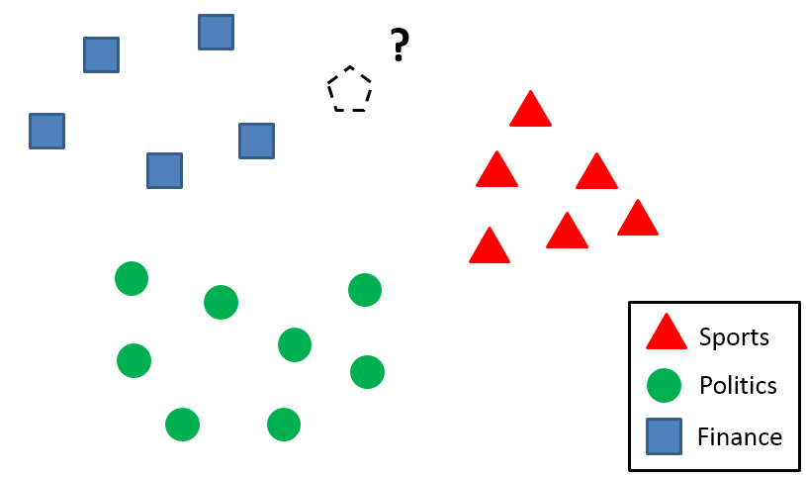

Efficient instance look-up
Approximate solution
Locality sensitive hashing
Similar documents -> (likely) same hash values
h(x)

Slide 14
Efficient instance look-up
Approximate solution
Locality sensitive hashing
Similar documents -> (likely) same hash values
Construct the hash function such that similar items map to the same “buckets” with high probability
Learning-based: learn the hash function with annotated examples, e.g., must-link, cannot link
Random projection

Slide 15
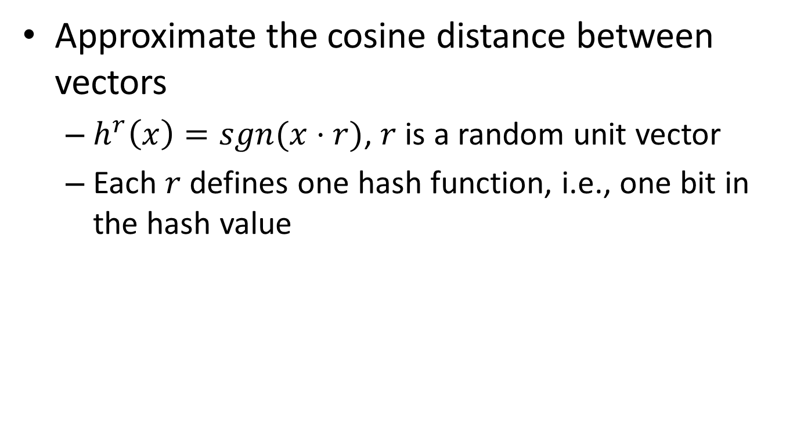
Random projection
Approximate the cosine distance between vectors
$h^{r}\left(x\right)=sgn(x⋅r)$, $r$ is a random unit vector
Each $r$ defines one hash function, i.e., one bit in the hash value

Slide 16
Weight the nearby instances
When the data distribution is highly skewed, frequent classes might dominate majority vote
They occur more often in the k nearest neighbors just because they have large volume
?
Sports
Politics
Finance

Slide 17
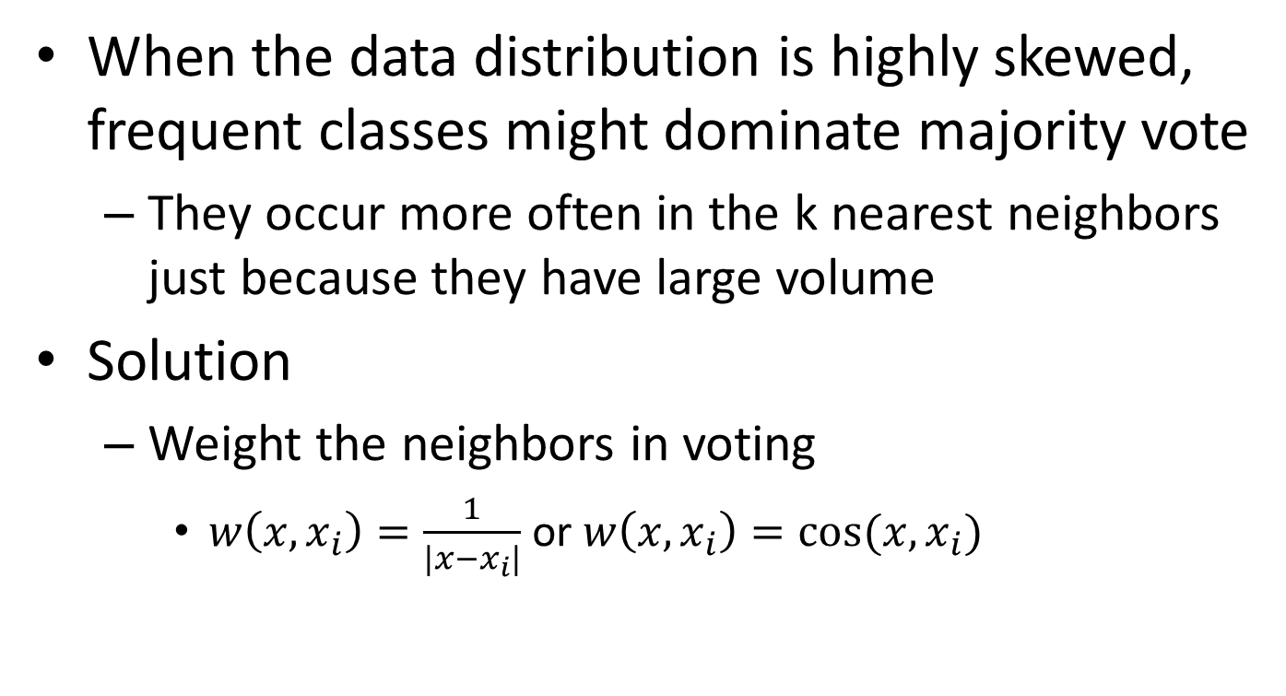
Weight the nearby instances
When the data distribution is highly skewed, frequent classes might dominate majority vote
They occur more often in the k nearest neighbors just because they have large volume
Solution
Weight the neighbors in voting
$w\left(x,x_{i}\right)=\frac{1}{|x−x_{i}|}$ or $w\left(x,x_{i}\right)=cos⁡(x,x_{i})$

